Slide 1

End-to-End Sales Prediction Solution for Retail Stores
Sumited by
Nilesh Choudhary

Slide 2
Content :
Project Over View
Data Pre-processing
Machine learning model building

Slide 3
Project Over View
As a Machine Learning Engineer at NextHikes, We are tasked with a sales forecasting project for Rossmann Pharmaceuticals. The finance team aims to predict sales across all stores in various cities, six weeks in advance. Historically, sales forecasting relied on managerial experience and judgment. Your objective is to deliver an end-to-end predictive solution to help the finance team plan effectively.

Slide 4
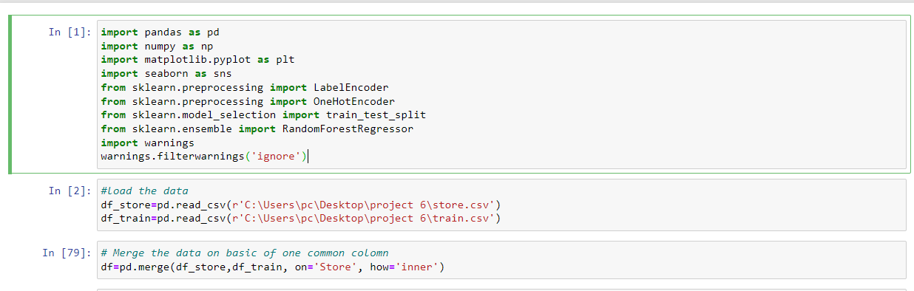
Import essential libraries
Load and merge the data

Slide 5
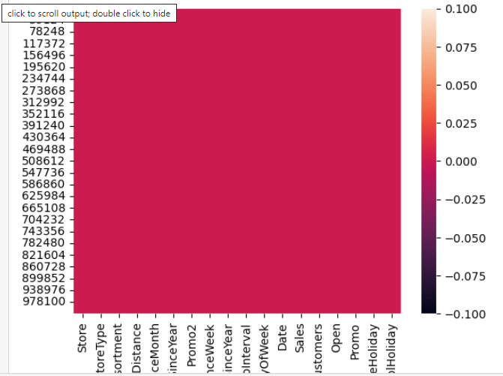
Fill null values and convert categorical data into numeric
Graphical representaion of null value after tretment

Slide 6
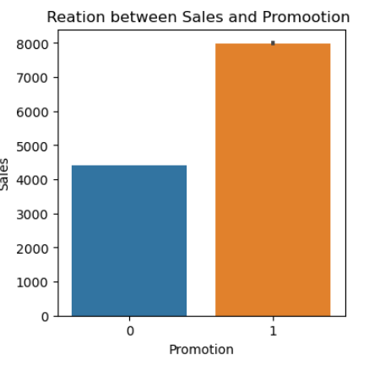
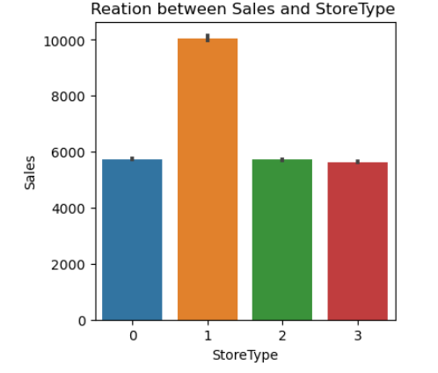
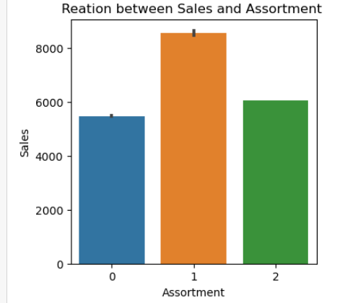
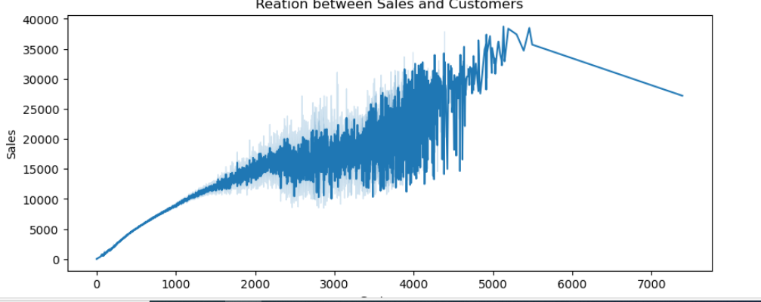
Visualization of important features

Slide 7
Split data in to train and test data
Train the mode
Mean Squared Error: 41673.23411053185
R-squared: 0.9971884045662451

